Slide 1
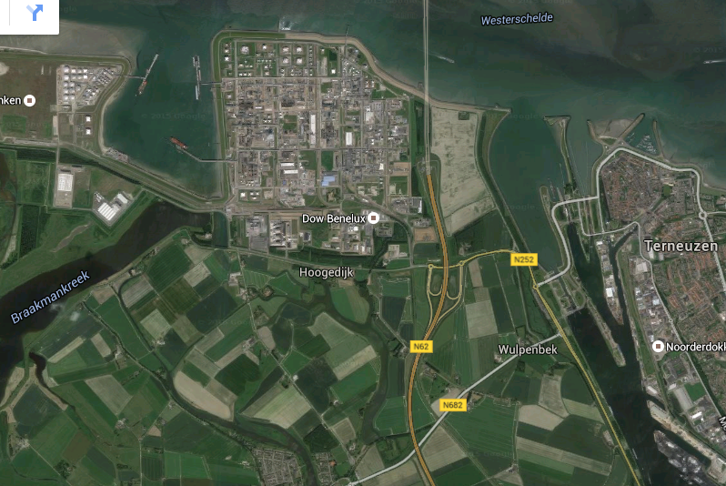
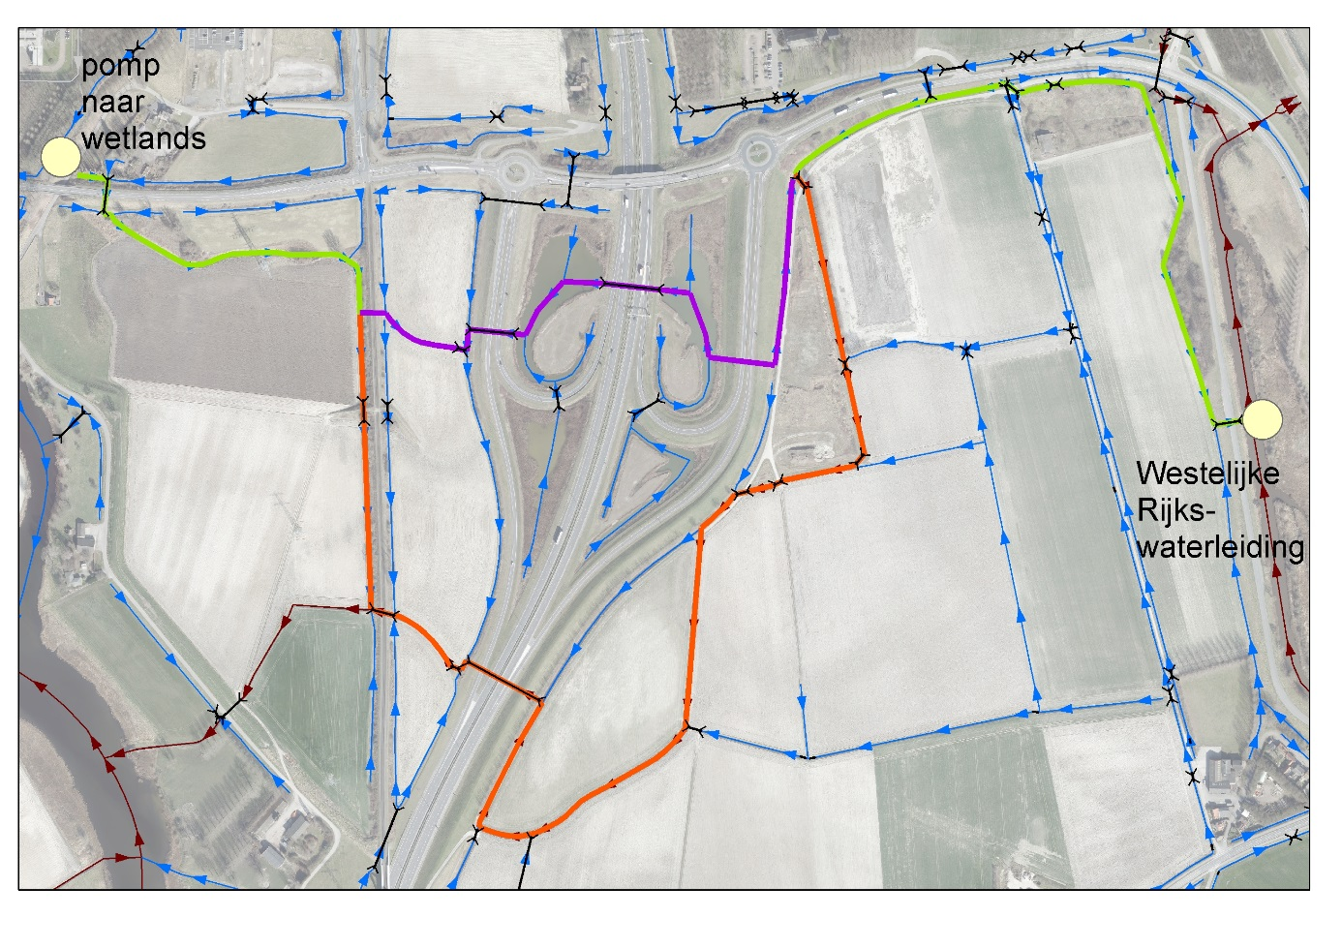

Wetlands as pretreatment for mild desalination facilitating a robust water system in Zeeuws-Vlaanderen
Hans Cappon
Tessa Steenbakker
Niels Groot
Introduction
The availability of fresh water is of vital importance to agricultural and industrial development. Although delta areas are attractive to industry, because of logistics, and to agriculture, because of fertile soils, the availability of fresh water is not always abundant.
One of the areas in the Netherlands with a lack of fresh water is the region of Zeeuws-Vlaanderen. Fresh water is transported from the remote Biesbosch basins to Zeeuws-Vlaanderen in order to facilitate one of the most dense industrial areas in the Netherlands along the Ghent-Terneuzen channel (Figure 1). With changing climate conditions and aiming for more sustainable solutions both industry and agriculture wish to be less dependent on external fresh water supply.
Results
A (desk)study on the applicability of wetlands as pretreatment for mild desalination indicates that combining a vertical flow filter of 2.5 ha with a horizontal flow field of 9.5 ha should be able to establish the required water quality. Such constructed wetland combination was estimated to cost 2.6 M€.
Water quality results indicate that WRWL water is best suited for industrial applications, whereas CTBD is not recommended to be filtered in the wetland, because of accumulation of non-biodegradable substances (i.e. phosphonates). Secondly, the salinity of the Lovenpolder runoff is often too high (7 mS/cm) to be treated in the envisioned mild desalination plant and hardly contributes to the yearly demand. Water from the Spuikom can easily be treated in the wetland, while Dow Biox can directly be fed to the desalination plant and does not need pretreatment.
The location of the wetland is important to the connecting infrastructure needed (Figure 2). The WRWL can be connected to the wetlands by means of existing ditches and watercourses. Some modifications to this existing infrastructure are needed, but costs are relatively low, near 400 k€. The ecological impact of such connection was estimated to be negligible. Additionally, a pumping station is needed to feed the wetland, which is estimated to cost 1.7 M€ at most, resulting in an overall cost of €0.4 to €0.5 per m³ of water, including mild desalination.
With the wetland in place, sourcing from the existing Biesbosch pipelines would still be needed at least 10% of the time, especially in dry periods.
Conclusion
Although the combination of wetlands and mild desalination requires high investment costs, the associated risk mitigation in case of water shortage is substantial, especially for chemical industries like Dow. In order to prove the feasibility of the approach, a combined wetland – mild desalination pilot study is recommended, which is the envisioned next step towards a more robust water system.
Figure 1 – The Lovenpolder in Zeeuws-Vlaanderen with the Dow Benelux plant to the north,
the Ghent-Terneuzen channel to the east and the Braakman-creek to the west.
Brackish water is predominant in this area.
Aim
The local fresh water demand is at least 550 m³/h, largely used for industrial cooling. Various water sources are available in the industrial area near the Western Scheldt, which may be used to meet this demand:
Cooling tower blowdown from both Dow Benelux and Elsta’s steam and power plant;
Rain water runoff from the Dow facility, currently collected in the Spuikom basin as fire water;
Runoff and WWTP effluent collected in the Westelijke Rijkswaterleiding (WRWL) and currently discharged to the Western Scheldt;
Runoff of the Lovenpolder, currently discharged to the Braakman;
Effluent from the biological WWTP of Dow, the Biox.
All these sources are brackish, which means a mild desalination step is needed in order to provide fresh water of adequate quality. Moreover, there are seasonal changes to the water quality, which are mainly related to the nutrient load and suspended solid content. In order to pretreat the brackish water prior to desalination, the feasibility of using wetlands is studied in this Deltafonds project.
The wetland should at least fulfil the following requirements:
Reduce nutrient loads and suspended solids of the brackish influent;
Act as a buffer in times of abundancy and shortage;
Serving multiple goals: water source for local farmers and industry, fitting with the landscape, attractive for tourism (hiking / biking).
Figure 2 – Overview of the connecting infrastructure needed from WRWL to wetlands. Existing watercourses are indicated in blue, the envisioned routes in green and purple/orange.
Partnership
The project was carried out by HZ University of Applied Sciences, Sweco, Deltares, Province of Zeeland, water board Scheldestromen, Dow Benelux, Evides water company, Staatsbosbeheer and Ghent University. Funding was provided also by Deltafonds and TKI Water Technology.
Contact:
dr. ir. Hans Cappon
hans.cappon@hz.nl
+31 (0) 118 489 216

